Slide 1


CO1-AT3-Technical Presentation
Role of Data Centers in Cloud Computing
Name: Mohammed Arshad R
Reg no:192521126

Slide 2


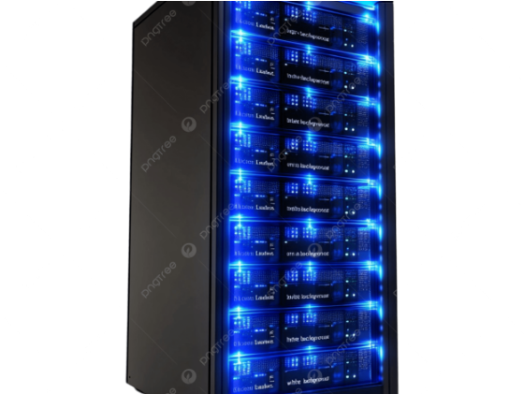
Methodology: Hardware Virtualization
Hypervisor Abstraction: Decouples physical x86/ARM servers into isolated Virtual Machines (VMs) and containers.
Multi-Tenancy Framework: Allows thousands of tenants to safely share CPU, RAM, and NVMe drives with strict logical security borders.
Dynamic Resource Pooling: Aggregates physical compute clusters into unified, elastic capacity pools for instantaneous provisioning.
Automated Orchestration: Middleware (e.g., Kubernetes, OpenStack) manages real-time workload scheduling and automated failover.

Slide 3
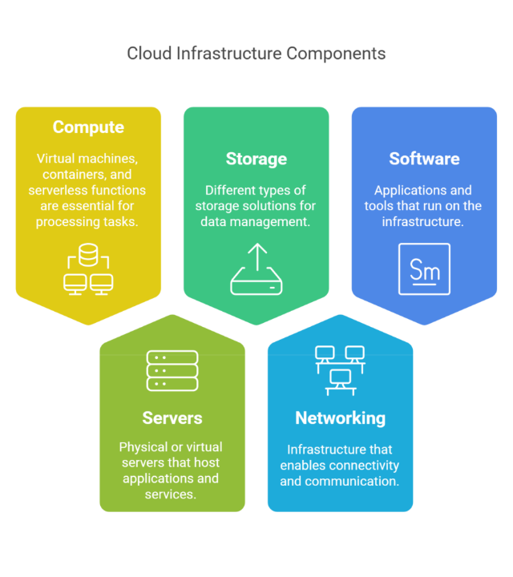

Data Center Network Topology
Spine-Leaf Architecture: Modern cloud data centers replace traditional tree topologies with two-tier Spine-Leaf fabrics, ensuring predictable non-blocking East-West traffic and ultra-low latency between microservices.
Software-Defined Networking (SDN): Programmatically decouples network control planes from data planes, enabling dynamic VXLAN overlays, automated firewalling, and intelligent load balancing across server racks.
Storage Disaggregation: Fast distributed SAN/NAS systems connect via high-bandwidth optical channels, supplying scalable block, object, and file storage on demand.

Slide 4







How Data Centers Support Cloud Services
IaaS Infrastructure
PaaS Enablement
SaaS Delivery
Provides direct access to bare-metal servers, virtual storage volumes, and network adapters, giving users full control over operating systems and software stacks.
Data centers host pre-configured application runtimes, managed relational databases, and serverless compute instances, freeing developers from managing physical hardware.
Powering end-user web applications (e.g., email, productivity suites) with automated horizontal scaling, geo-replication, and zero-downtime maintenance updates.

Slide 5



Conclusion: The Cloud Backbone
High Availability
Rapid Elasticity
Geo-Distribution
Data centers enforce N+1 or 2N hardware redundancy for UPS power, cooling, and network links, fulfilling strict 99.999% Service Level Agreements (SLAs).
Physical resource pooling enables workloads to scale seamlessly from single container instances to thousands of compute nodes within seconds.
Strategically positioned global availability zones minimize round-trip latency (RTT) and ensure strict adherence to local data sovereignty laws.

Slide 6

References
Armbrust, M., Fox, A., Griffith, R., Joseph, A. D., Katz, R., Konwinski, A., Lee, G., Patterson, D., Rabkin, A., Stoica, I., & Zaharia, M. (2010). A view of cloud computing. Communications of the ACM, 53(4), 50–58. https://doi.org/10.1145/1721654.1721672
Barroso, L. A., Clidaras, J., & Hölzle, U. (2013). The Datacenter as a Computer: An Introduction to the Design of Warehouse-Scale Machines (2nd ed.). Morgan & Claypool Publishers.
Al-Fares, M., Loukissas, A., & Vahdat, A. (2008). A scalable, commodity data center network architecture. Proceedings of the ACM SIGCOMM Conference, 63–74. https://doi.org/10.1145/1402958.1402967
Wang, B., Qi, Z., Ma, R., Guan, H., & Vasilakos, A. V. (2015). A survey on data center networking for cloud computing. Computer Networks, 91, 528–547. https://doi.org/10.1016/j.comnet.2015.08.040
Buyya, R., Yeo, C. S., Venugopal, S., Broberg, J., & Brandic, I. (2009). Cloud computing and emerging IT platforms: Vision, hype, and reality for delivering computing as the 5th utility. Future Generation Computer Systems, 25(6), 599–616.

